Slide 1
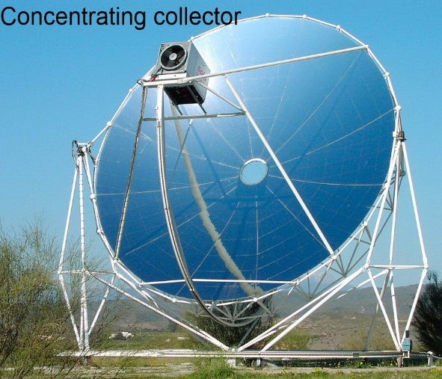
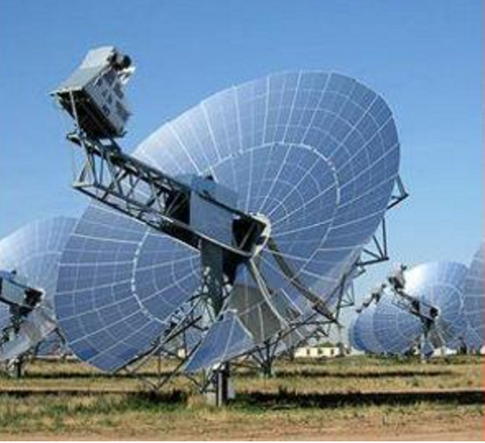
Solar Thermal Generator Team # 14
Ernest Crabtree * Jason Galla * Will Sidebottom * Dylan Lee *Benjamin Galivan * Shazeen Tariq
Instructors : Dr. Rajendra K. Arora, Ph.D Dr. Jerris J. Hooker, Ph.D Sponsor : Dr. Michael D. Devine, Ph.D

Slide 2
Problem Statement
Needs Statement : “ A less expensive and easily obtainable power system is required for power outages or camping trips.
Goals Statement : “Develop a portable device that transforms solar thermal energy into usable electricity.”

Slide 3
Objectives
Produce 20 W of power from an easily accessible sun source.
Minimize the weight of the device to ensure portability.
Produce a device that is safe to operate and leaves negligible negative ecological consequences.
Produce a device that is conveniently setup and disassembled

Slide 4
Project Scope
Solar Collection
Solar Tracking
Motion/Fixed Mount
TEG Cooling & Heat Dissipation
Energy Storage & Power Output
Scalability
Programming Model

Slide 5
Ergonomics
User interface
Outputs for power should be standard USB and 12 V Car Type outlet
Indicators for charge status and availability
Set up
Indicator for initial north position
GPS enabled
Ease of Use
Smart Phone app for set-up and information delivery

Slide 6
Constraints
Device weight must not exceed 30 lbs
Water resistant to corrosion
Assembly should be simple and quick.
Meet all safety standards applicable
Provides maximum standby time
Comply within the range of a provided budget.

Slide 7

Solar Collection
Solar radiation is our most abundant source of “free” energy.
PV cells use only a portion of the available radiated energy.

Slide 8
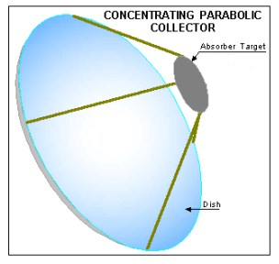
Solar Collection
Use a parabolic collector to focus radiation
Average of 1000 W / meter squared
Our dish area is 550 sq in. = 0.36 m^2
Estimated collection is 360 W
Given a common TEG efficiency of 7% this should produce about 25 W output
Focus will be on improved efficiency

Slide 9

Control
Mount will be a 2 axis gimbal type
Will be drive by two servos
PWM from microcontroller for precise motion
Low power mode in between motions ( every 15 to 30 min.)

Slide 10
Solar Tracking Algorithm
The National Renewable Energy Lab provides an open source library to track the position of the Sun.
Other open source libraries exist in other languages, but the C language is native to almost every micro controller.
The library has an uncertainty of +/- 0.0003

Slide 11
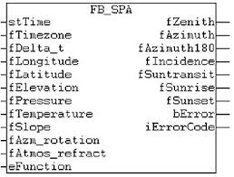
Solar Tracking Algorithm
Input: current date, time, and location data
Output: the zenith, azimuth, and incidence angles of the Sun.

Slide 12
Solar Tracking Algorithm
Need a way to get the proper data for the solar tracking algorithm
Best solution: GPS module coupled with a MCU
A familiar board: TI MSP430

Slide 13
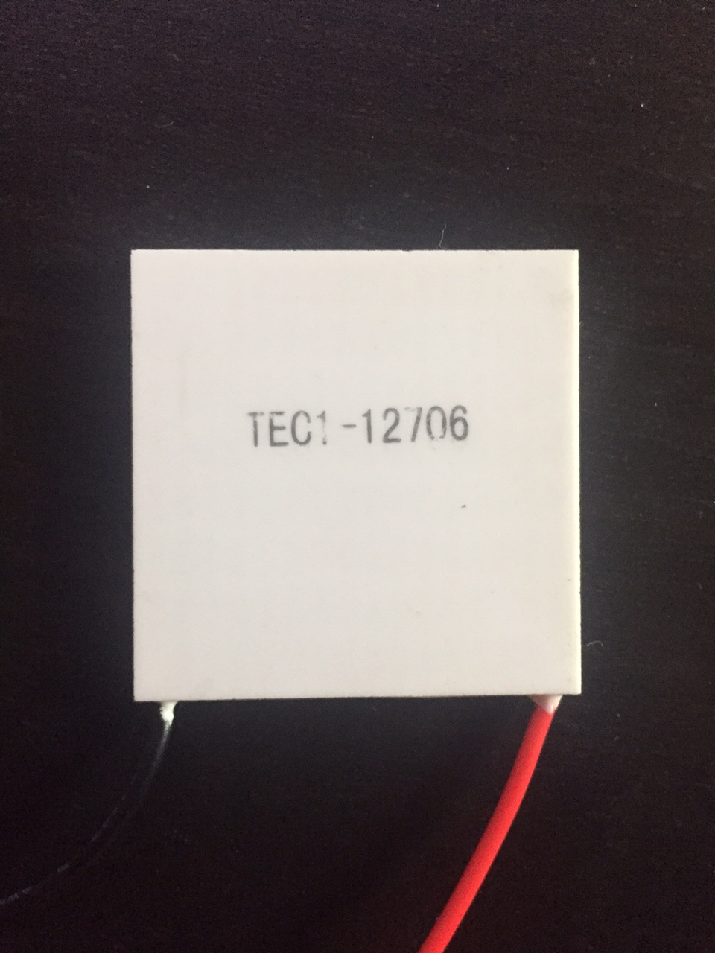
Thermoelectric Generator (TEG)
TEGs convert electric energy to thermal energy or can convert thermal energy to electric energy
Requires a temperature gradient (one side to be hotter than the other)

Slide 14
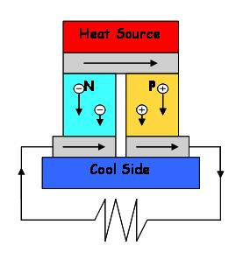
Thermoelectric Generator (TEG)
Example diagram:

Slide 15
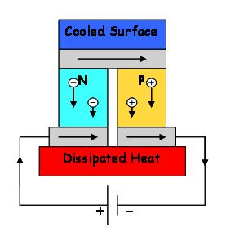
Thermoelectric Generator (TEG)
The Peltier effect is the opposite of the Seebeck effect
Creates an electric heat pump from electrical energy

Slide 16
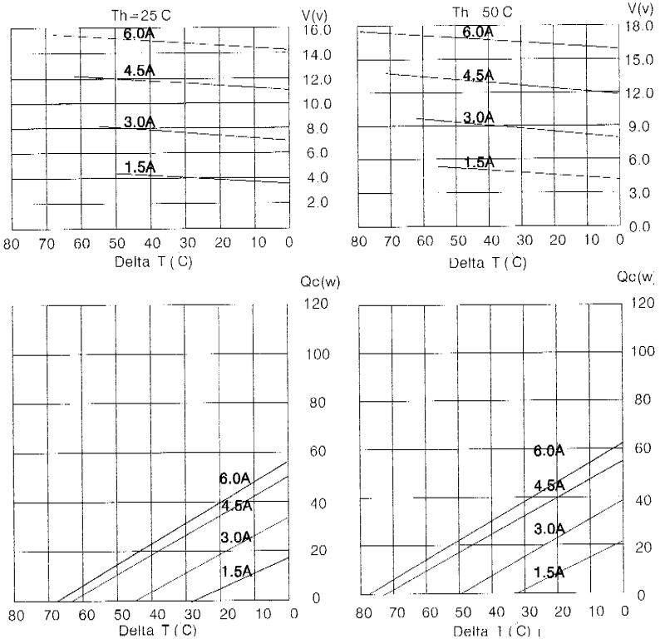
Thermoelectric Generator (TEG)

Slide 17
Voltage regulation
Depending on output voltages and configuration of chips, temperature gradients, etc, it may be necessary to step voltage up or down
Linear voltage regulation is too inefficient for our current application
Switching power supply (boost or buck converter) is much more efficient

Slide 18
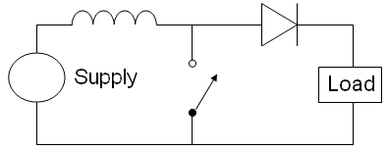
Voltage regulation
Switching supply uses inductor’s energy storage properties
Inductor short circuits and voltage builds then built up energy is dumped into capacitor

Slide 19
Voltage regulation
Need a way to short circuit the loop
Best approach is a MOSFET with a square wave controlling it
Duty cycle of square wave and Inductor capacity determine the voltage gain and also determine the voltage ripple
Circuit can be more complex to build in safety and also smooth the output voltage better

Slide 20
Voltage regulation
Can achieve much higher efficiency than linear voltage regulation (90%)
Does not dissipate as much heat as linear voltage regulator
Hence requires less cooling

Slide 21
TEG Cooling and Heat Dissipation
Objective:
Maximize chip output by increasing temperature gradient.
Challenge
Dissipate heat from cool side of chip using little to no power.

Slide 22
TEG Cooling and Heat Dissipation
Possible Solutions
Initial Prototype
Aluminum fin-style CPU heatsink.
Benefits (When used as is)
No power consumption/Natural Convection only.
Greater surface area maximizes heat dissipation.
Low cost.
Disadvantages
Cooling is improved with use of fan.
Bulky.

Slide 23
TEG Cooling and Heat Dissipation
Final Design
Water cooling system utilizing water block and radiator.
Benefit
Provides greater heat-dissipation than conventional fan cooling or natural convection.
Disadvantage
Consumes Power.

Slide 24
TEG Cooling and Heat Dissipation
Final Design
Ferro-fluid cooling system utilizing electromagnetic convection.
Benefits
Provides greater heat-dissipation than conventional fan cooling or natural convection (Possibly).
No power consumption.
No moving parts.

Slide 25
Website Design
Design
Language used: HTML and external CSS.
Including bootstrap libraries to handle scaling and to make website mobile friendly.
Hosting
Can view website progress on brg12.github.io
Utilizing Github to build and host website.

Slide 26
Nickel Metal Hydride vs Lithium Ion
Nickel Metal Hydride Battery
Pros | Cons
Cheap ($34 for 12 count pack) | Heavy
Can be recharged and reused 150-500+ times | Lose power when sitting idle (1% per day) Need to be recharged and used every 1-2 months
Steady and lasting discharge | Begin to hold charges for shorter periods late in their life cycle
Delivers energy capacity at a more constant rate (flatter discharge rate) | Should not be stored in warm areas (affects longevity)
Much safer than Lithium. Environmentally friendly. | Must be charged before first use
Recyclable | Suffer from memory effect.
Low internal impedance | Low operating voltage (1.2 V)
Can tolerate overcharge and over discharge due to safety vents that depressurize cell
Rapid Charge possible in 1 hour
Lithium Ion Battery
Pros | Cons
Low discharge rate (retain charges longer than any other battery) | Loses energy capacity with time (even if not used)
High energy density (stores more energy in a smaller and lighter battery) | Expensive ($4-$20 per battery)
500-1000+ number of recharging cycles | Dangerous. Overcharge may result in cell rupture.
High cell voltage (3.6 V-3.7 V) | High voltage capacity can make the battery too powerful for some devices and can damage circuitry
 | Require battery management system

Slide 27
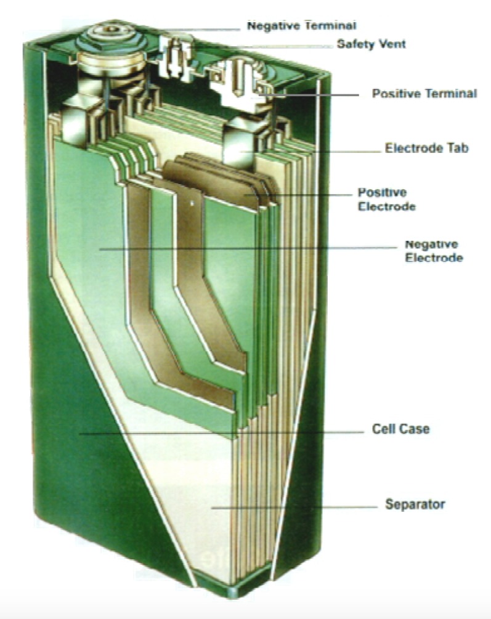
Nickel Metal Hydride Specifications
Proven in consumer applications
Sealed battery system offers low maintenance and non-leakage
Offers operation over wide temperature ranges
Long life characteristics
High energy density

Slide 28
Next Step
Acquire Nickel Metal Hydride Batteries
Develop, implement, and test a circuit to charge and discharge batteries by limiting voltage and current from the TEG’s and output to the load.
TEG’s
Solar Collection
Thermal Heat to Voltage
NiMH Battery Array
Charging Circuit
Voltage Output Circuit
Output
12 V
5 V

Slide 29
InNOLEvation Challenge
The InNOLEvation Challenge is a Business Model Competition with a focus on identifying problems and potential solutions, building effective teams and precisely defining the assumptions of a new venture, testing those assumptions in the field, and then pivoting based on the lessons learned.

